Slide 1



E-Commerce Project
View in Power BI
Last data refresh:
6/21/2025 9:36:54 AM UTC
Downloaded at:
6/21/2025 9:40:08 AM UTC

Slide 2
FINANCIAL ANALYSIS
Analyzing total revenue growth over time
Identifying best-selling products and seasonal sales trends. Calculating the average order value to understand spending behavior.

Slide 3
CUSTOMER INSIGHTS
Identifying top-performing locations based on sales volume.
Analyzing order cancellation trends and customer retention.
Differentiating B2B vs. B2C customer behavior for targeted marketing.

Slide 4
PRODUCT MANAGEMENT
Identifying high-demand product
categories.
Analyzing the average quantity ordered
for efficient stock management.
Enhancing inventory control to prevent
stockouts or overstocking.

Slide 5
Customer and Logistics
Investigating high return and cancellation rates. Identifying problematic
products/categories to enhance quality. Improving customer experience through better service
Addressing shipping delays by calculating average shipping times.
Comparing orders fulfilled by Amazon vs. Merchant fulfillment.
Improving order processing for faster deliveries.

Slide 6

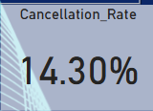
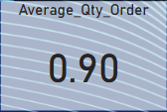
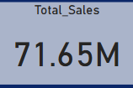
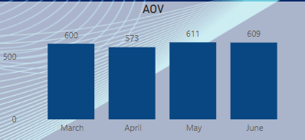
Key performance
Aggregation

Slide 7
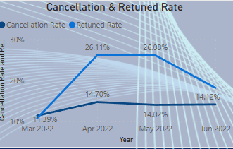
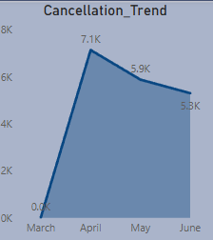
Cancellation and Returned Overview
.

Slide 8
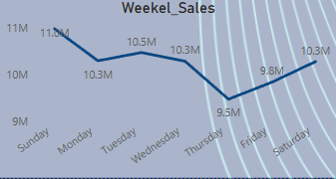
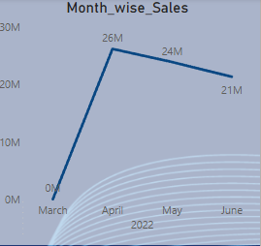
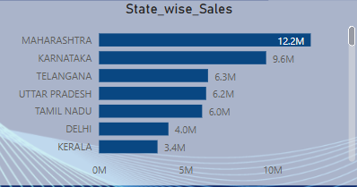
Sales Overview
.

Slide 9
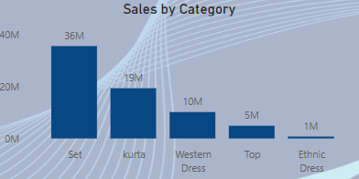
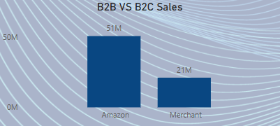
Category and Channel Sales Overview
.

Slide 10
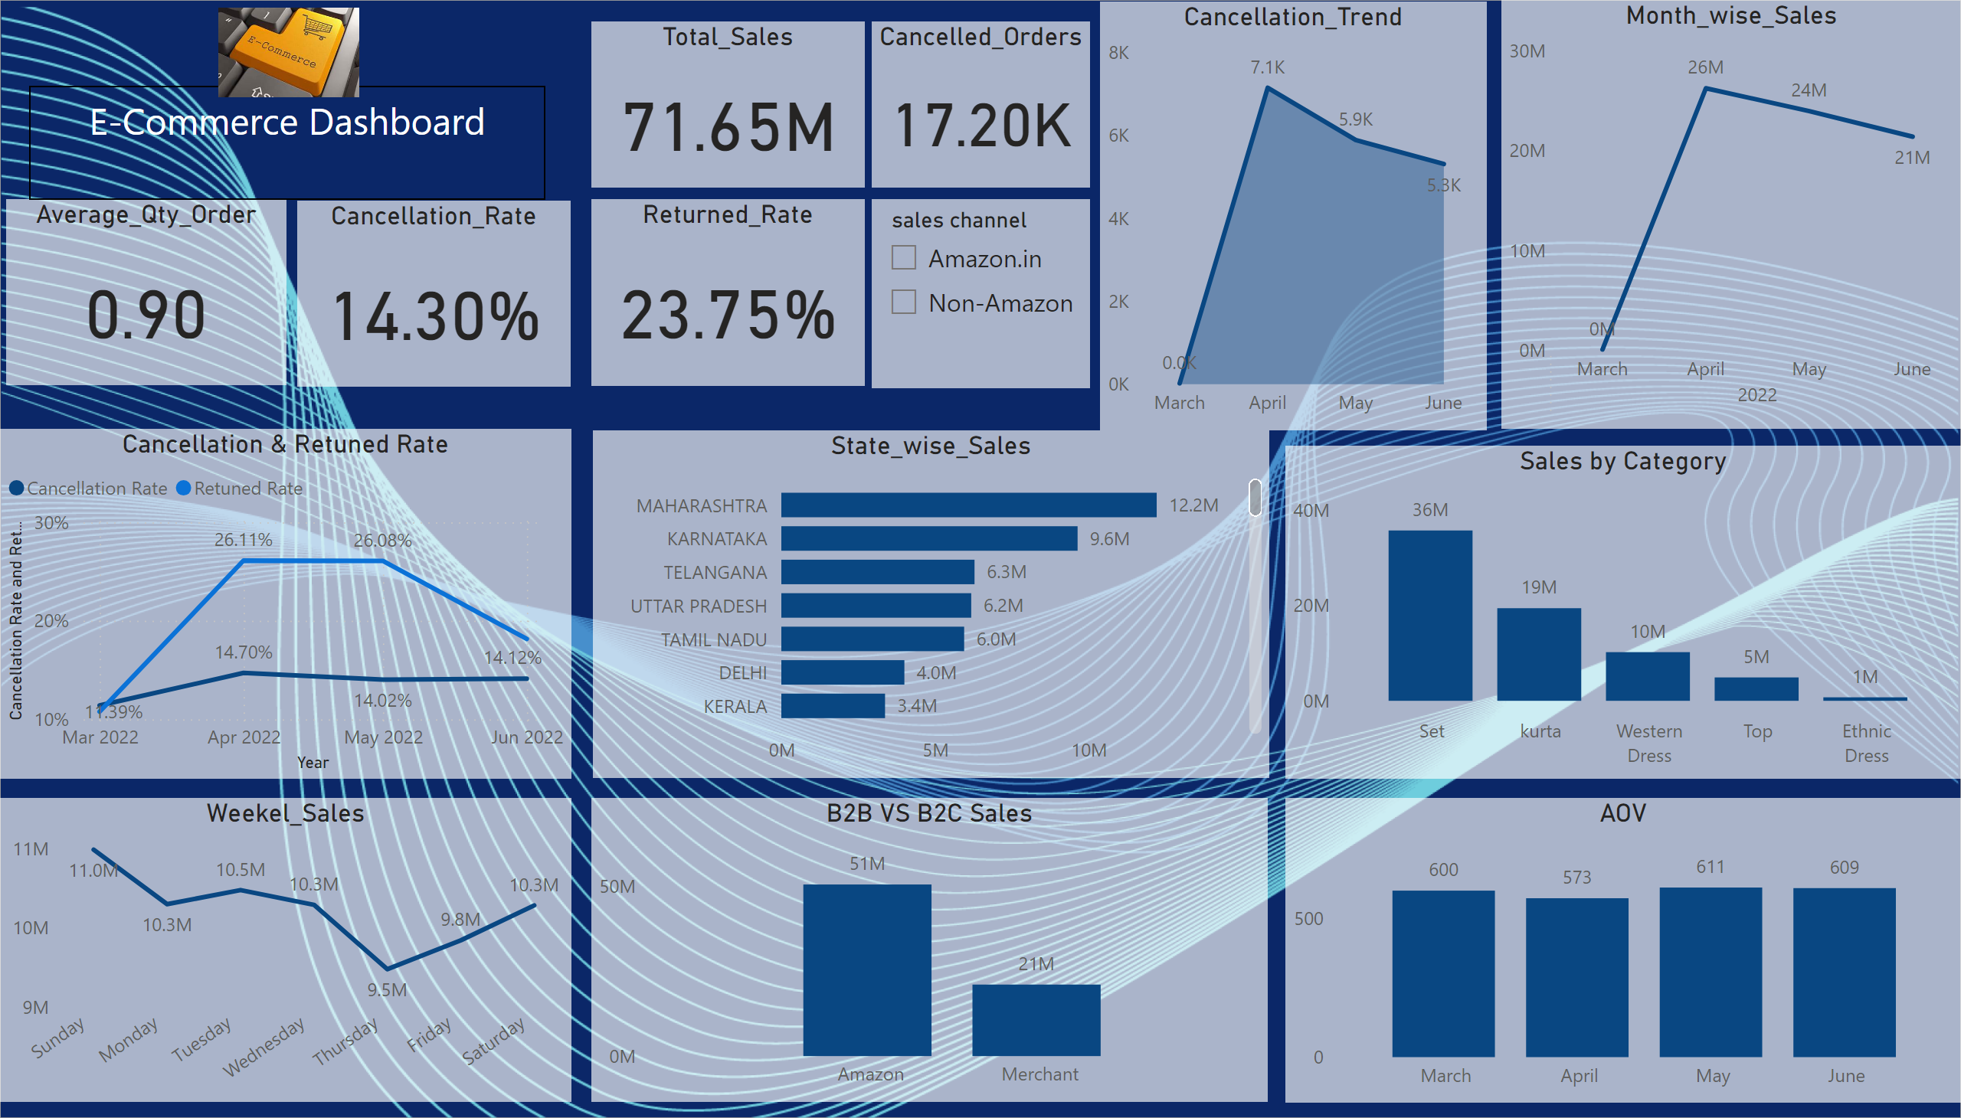
Page 1
Notes:
Returned_Rate
No alt text provided
Total_Sales
No alt text provided
Cancelled_Orders
No alt text provided
slicer
No alt text provided
Month_wise_Sales
No alt text provided
Sales by Category
No alt text provided
AOV
No alt text provided
Cancellation_Trend
No alt text provided
State_wise_Sales
No alt text provided
B2B VS B2C Sales
No alt text provided
Weekel_Sales
No alt text provided
Average_Qty_Order
No alt text provided
Cancellation & Retuned Rate
No alt text provided
textbox
No alt text provided
Cancellation_Rate
No alt text provided
image
No alt text provided

Slide 11
Conclusion
Cancelled:
Cancelled and "Returned" orders appear frequently so we need to .
Some months show high cancellation rates, especially via merchant fulfillment.
Fulfillment Performance:
Mixed performance between "Amazon" and "Merchant" fulfillment.
"Merchant" fulfilled orders have higher instances of cancellations.
Category-Level Issues:
Categories like kurta, top, and set dominate.
Some categories may correlate with higher return or lower AOV.
Geographic Distribution:
Top shipping states include Maharashtra, Karnataka, and Tamil Nadu.
Slight delays and higher cancellations may be localized to specific regions.
Sales Strategy bold text Boost AOV by offering product bundles, free shipping thresholds, or upselling.
Run targeted category-level promotions for low-performing items.

Slide 12
Recommendation
Promotion:
Promote bundles or combos to increase order value (e.g., kurta + pant + dupatta).
Encourage larger orders by offering free shipping above a certain amount.
Cross-sell and upsell using customer preferences (e.g., show matching products).
Focus on top-selling categories, reduce low performers
Improve Product Listings:
Use high-quality images and accurate descriptions.
Clearly display size charts to reduce size-related returns.
Be transparent to set correct customer expectations.
Improve Merchant Fulfillment SOP:
Faster dispatch times.
Standardize packaging and labeling.
Weekly & Monthly Dashboards:
Sales, returns, cancellations, and top SKUs by time.

